Slide 1


Molecular modeling and Voronoi-Delaunay method in chemical physics
Alexej Anikejenko^{1,2}
¹Voevodsky Institute of Chemical Kinetics and Combustion
Laboratory of Molecular Dynamics and Structure, www.kinetics.nsc.ru/mds
²Novosibirsk State University
Novosibirsk, Russia

Slide 2

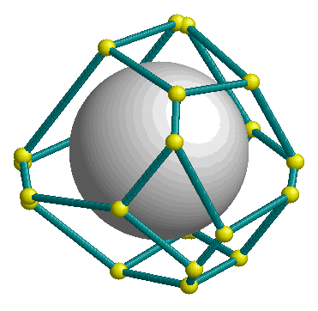
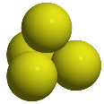



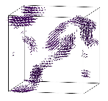
Talk overview
About where I came from
Voronoi-Delaunay method in structural research
Structure of Hard Sphere packings
Introduction to Molecular Dynamics (MD) simulations
MD simulations of solutions: DNA duplex in water
MD simulations of solutions: SNase protein, TMAO, TBA
Visualization of collective motions in water simulations
Concluding remarks

Slide 3
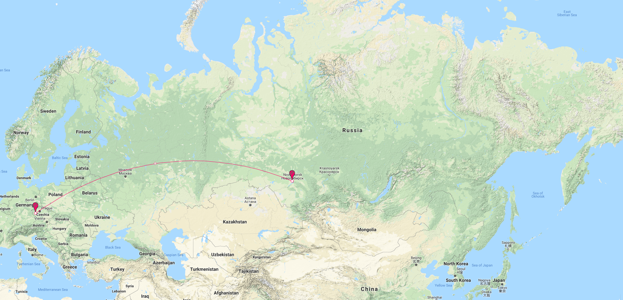
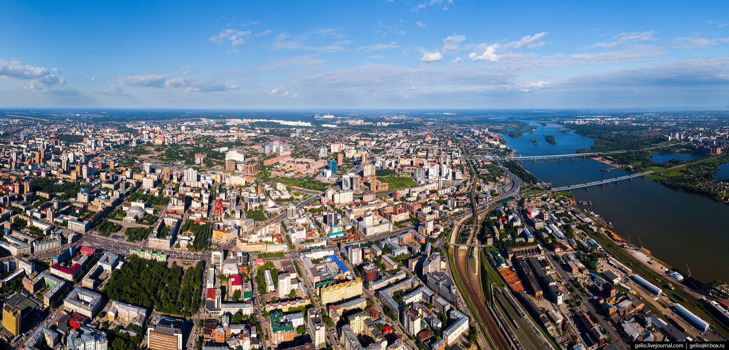
Novosibirsk city
Siberia (average temperature in January -20°C)

Slide 4
Novosibirsk city
3rd city in Russia by population: ~1.6M citizens
Industry, trade, culture, science

Slide 5
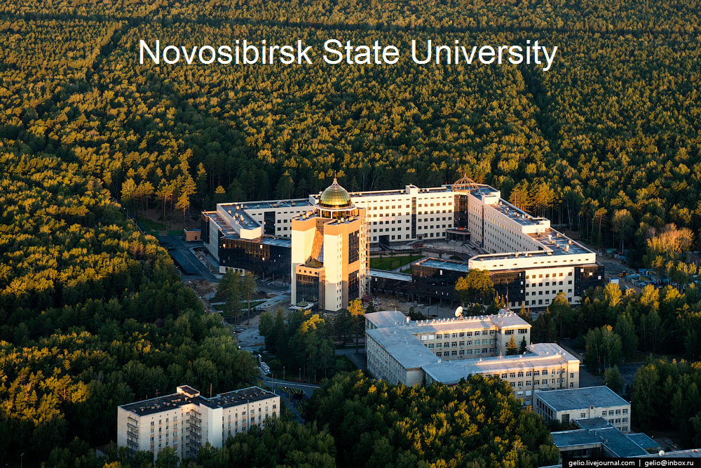
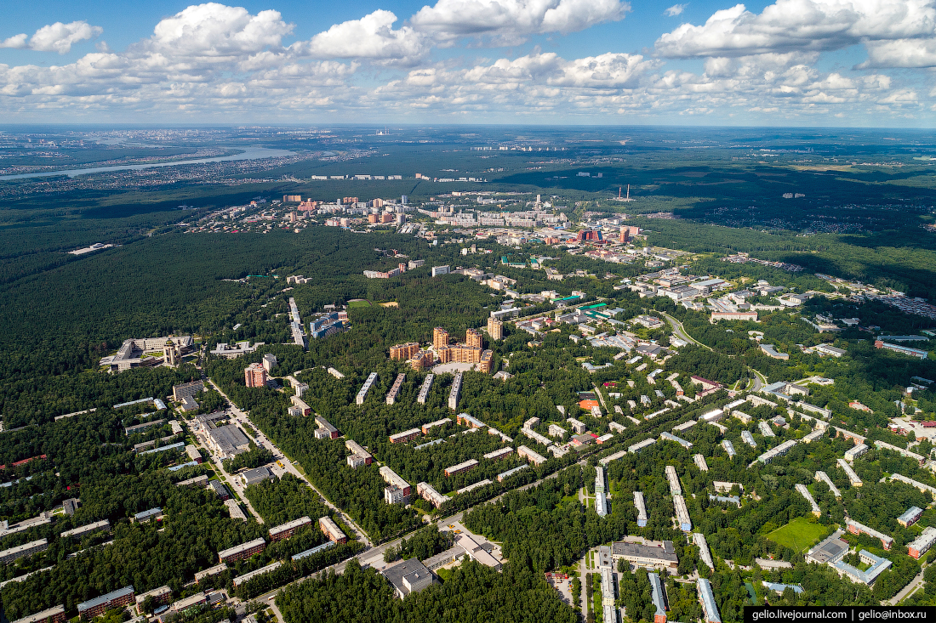
Novosibirsk Scientific Center - Akademgorodok
38 research institutes, a lot of green forest

Slide 6
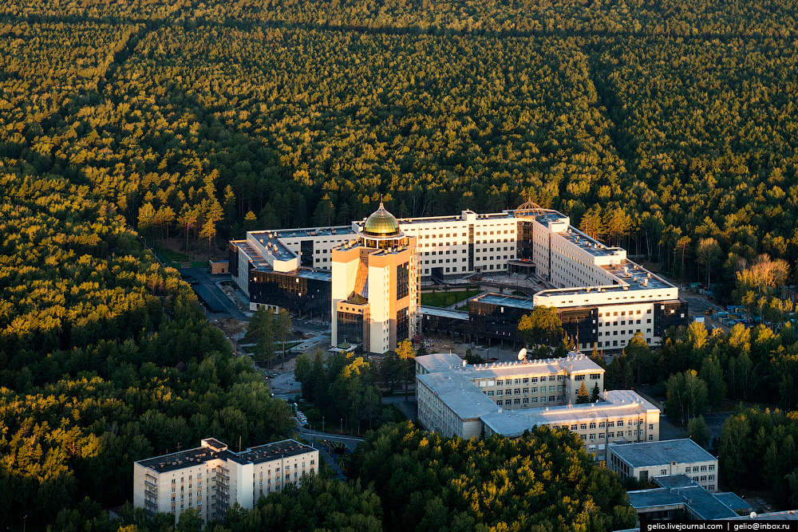
Novosibirsk Scientific Center - Akademgorodok
Novosibirsk State University

Slide 7
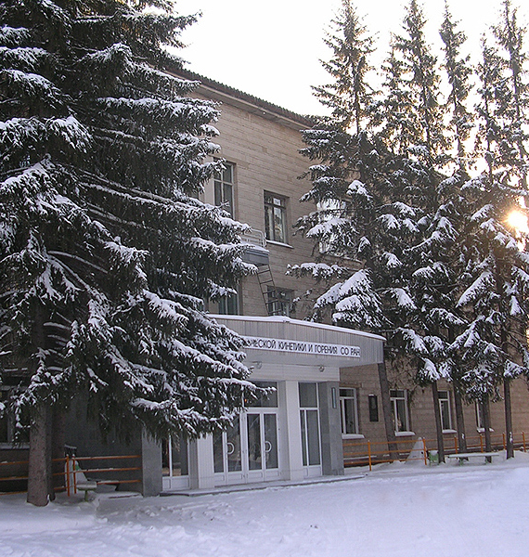
Institute of Chemical Kinetics and Combustion
www.kinetics.nsc.ru
~20 laboratories, ~200 researchers
Fundamental research of chemical and biochemical reactions. Strong positions in NMR/ESR spectroscopic methods. Computational and theoretical physical chemistry

Slide 8
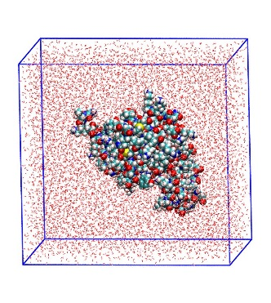
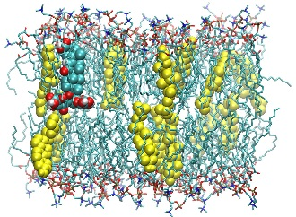
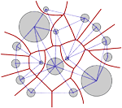
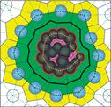
Lab of Molecular Dynamics and Structure
www.kinetics.nsc.ru/mds
Molecular Dynamics simulations
  Aqueous solutions of biomolecules and cosolvents
  Voids and permeability of lipid membranes
Voronoi-Delaunay method
  Cavities and interatomic voids
  Structure of sphere packings, liquids, glasses
  Calculation of the partial molar volume and its components for biomacromolecules in solution

Slide 9
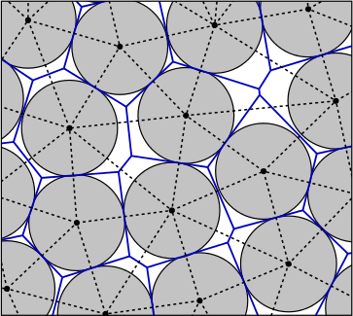
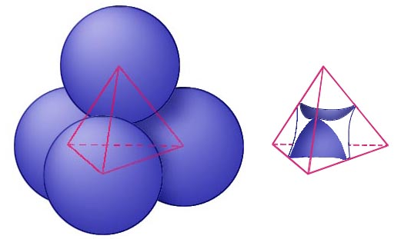
Voronoi-Delaunay method
Voronoi polyhedron
Delaunay simplex
Voronoi-Delaunay tessellation
Voronoi network – navigation map for interatomic space. Voronoi polyhedra and Delaunay simplexes are simple elements of structure

Slide 10
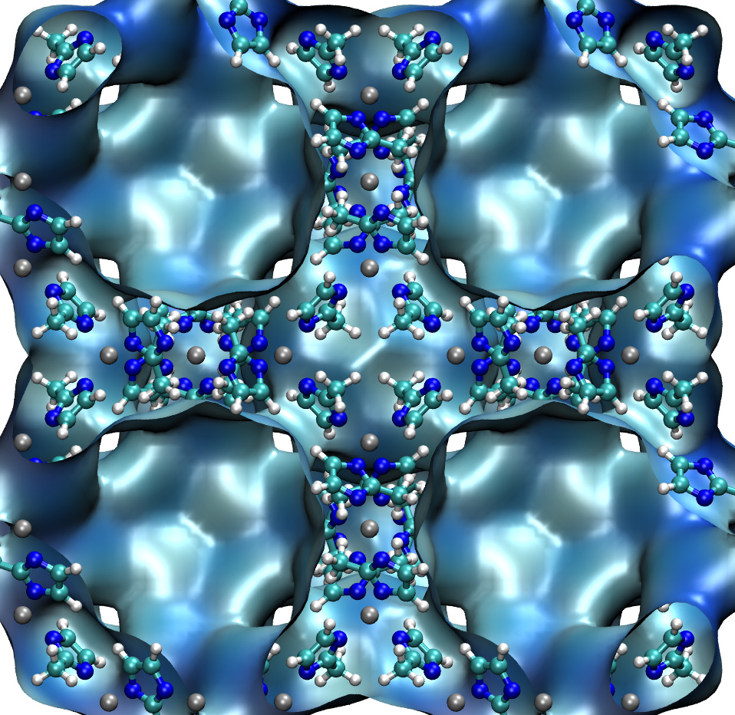
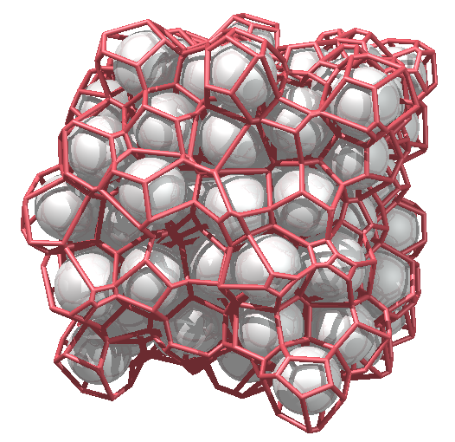
Voronoi-Delaunay method
Many applications in physics, chemistry, material science
Solid state physics
  Wigner–Seitz cell, Voronoi-Dirichlet polyhedra in crystal chemistry
Porous materials characterization
  Zeolites, MOFs, soots
Structure of liquids and glasses
  After work of J. Bernal “A geometrical approach to the structure of liquids” // Nature. 1959. 183 (4655). P. 141-147.

Slide 11
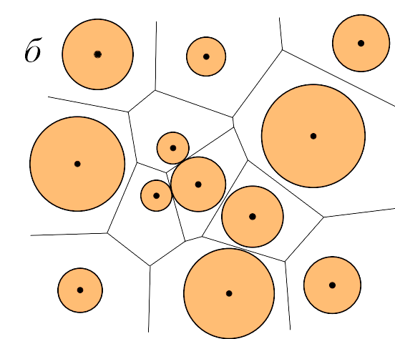
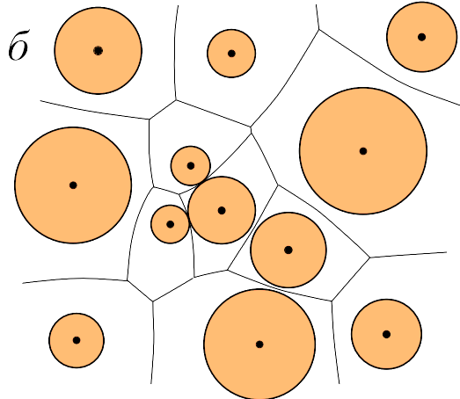
Voronoi-Delaunay method - generalizations
power diagram
additively-weighted VD
+ tessellations in periodic geometries

Slide 12
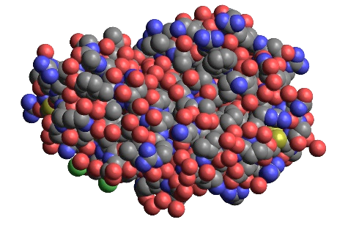
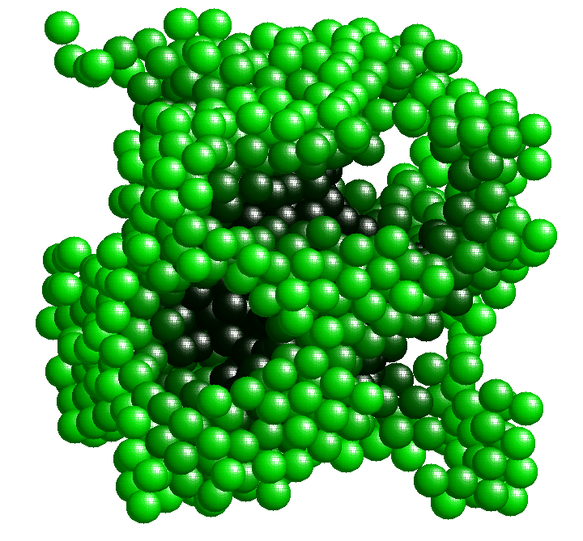
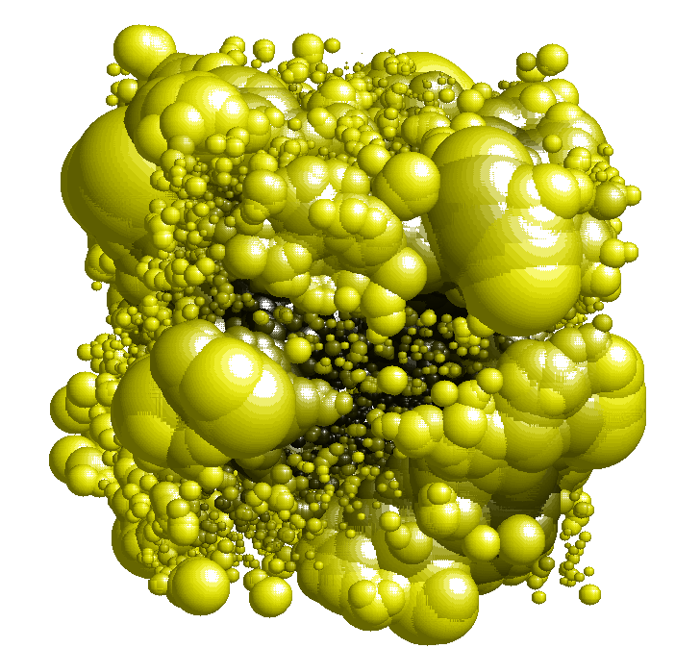
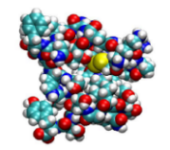
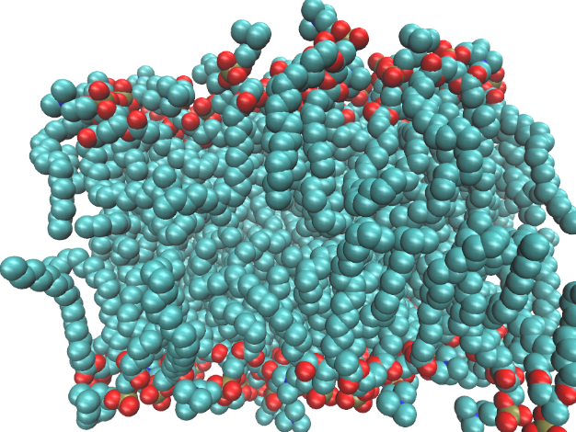

Voronoi-Delaunay method in molecular biology
1. Volume and surface of macromolecules
2. Cavities, channels, tunnels
3. Volumetric properties in solutions

Slide 13
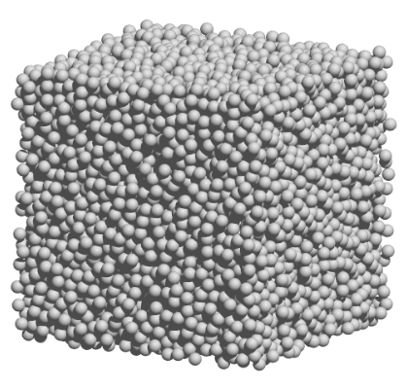
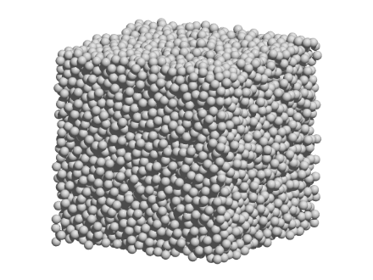
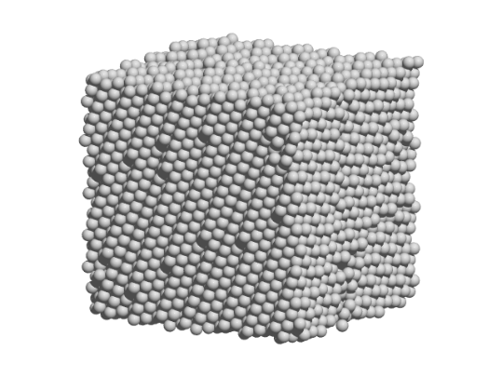
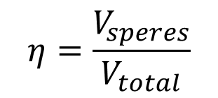
Structure of disordered sphere packings
…
…
Bernal’s density ≈0.64 ?
$$η=\frac{V_{speres}}{V_{total}}$$
0.55
0.60
0.65
0.70
0.75
Disordered, glass-like
Partially crystalline
Random Close Packing
The densest crystals (fcc, hcp) η ≈ 0.74…
Anikeenko, A. V. & Medvedev, N. N. Structural characteristics of close packings of hard spheres. Critical densities. Journal of Structural Chemistry 48, 774–781 (2007).

Slide 14
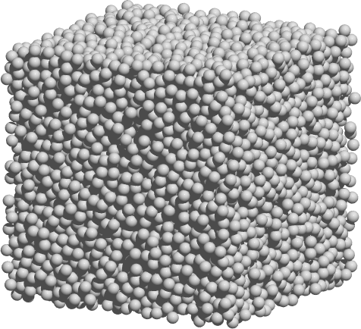
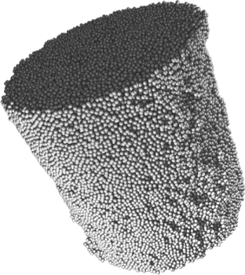
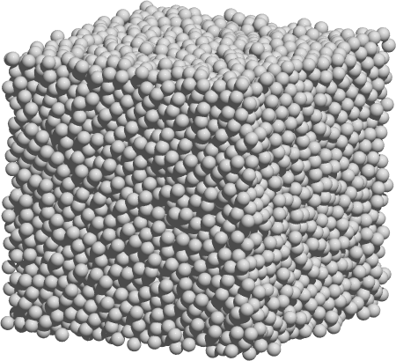
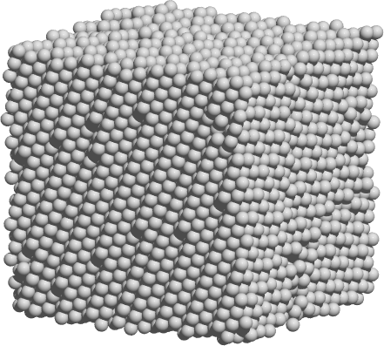
Structure of disordered sphere packings
Computer model packings with different degree of ordering
Experimental packings
212 models with 10’000 spheres in each
Aste, T. et al. Phys. Rev. E 71, 061302 (2005)
Lochmann, K. et. al Eur. Phys. J. B 53, 67–76 (2006)

Slide 15
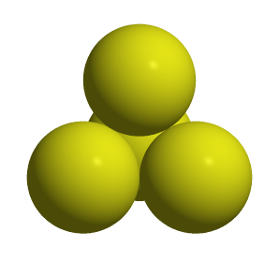
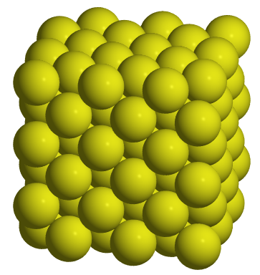
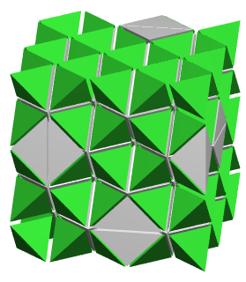
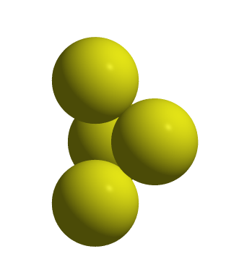
Sphere packings: Delaunay simplexes
regular tetrahedron
local density η ≈ 0.78
Delaunay triangulation of the fcc crystal
quartoctahedron

Slide 16
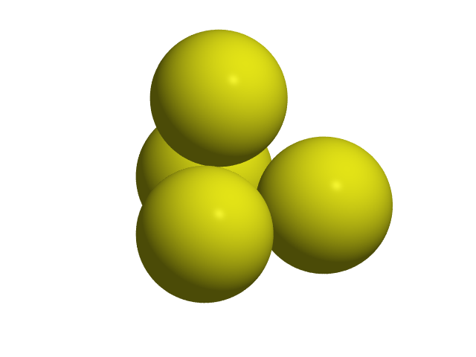

Simplex shape measures
δ
δ_{max}
Edge based shape measures
Procrustes distance (statistical theory of shape)
A. Anikeenko, M. Gavrilova, N. Medvedev, “Shapes of Delaunay Simplexes and Structural Analysis of Hard Sphere Packings”, in book Generalized Voronoi Diagram: A Geometry-Based Approach to Computational Intelligence. Studies in Computational Intelligence, Vol. 158, 2008, Springer-Verlag Berlin Heidelberg. pp. 13-45.

Slide 17
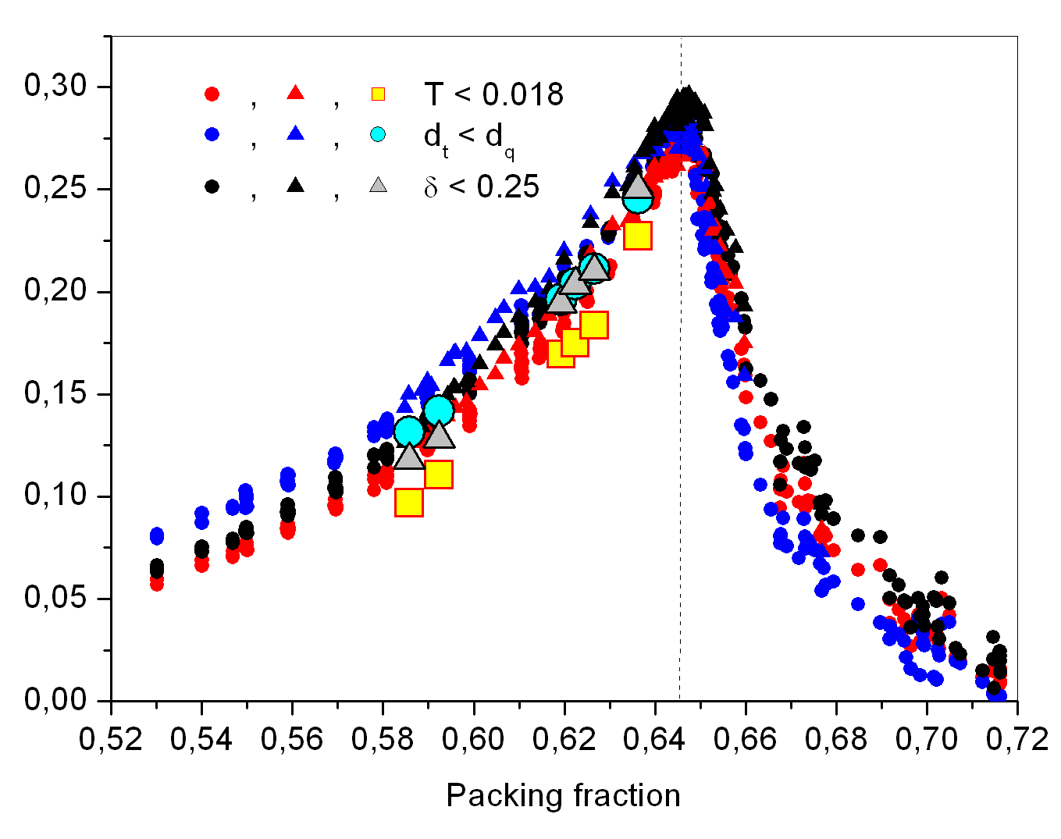
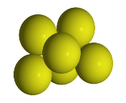
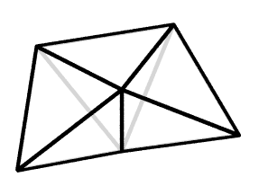
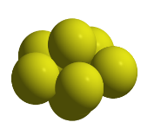
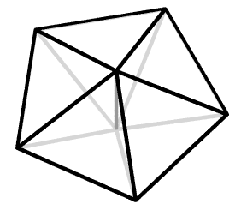
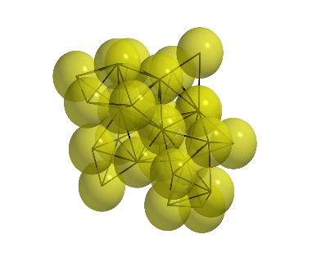
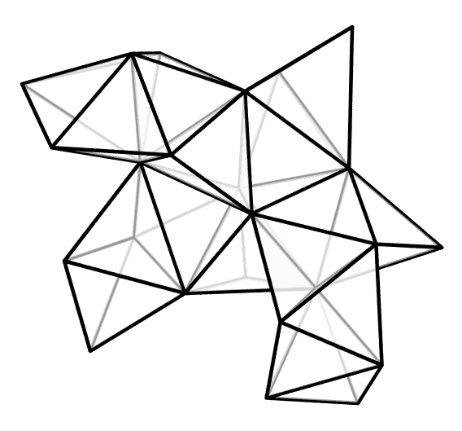
Polytetrahedral nature of random packings
η_{Bernal} ≈ 0.646
Volume fraction of polytetrahedra
Anikeenko, A. V., Medvedev, N. N. & Aste, T. Structural and entropic insights into the nature of the random-close-packing limit. Phys. Rev. E 77, 031101 (2008).

Slide 18
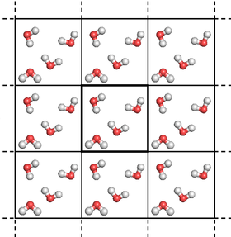
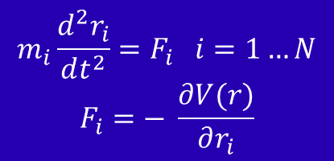


Molecular Dynamics simulations
$$m_{i}\frac{d^{2}r_{i}}{dt^{2}}=F_{i} i=1…N$$
$$F_{i}=− \frac{∂V(r)}{∂r_{i}}$$
Periodic boundary conditions
Newton equations of motion are solved numerically
Time step ~ 1 fs
Forces are derived from particle coordinates using empirical force-fields
Result is the MD-trajectory
MD-trajectory is „MD-movie“
$∆t≈{10}^{−15}$s
Averages are calculated across the ensemble and trajectory
$$\left\langle F\left(r^{N}\left(t\right), v^{N}(t)\right)\right\rangle$$

Slide 19
MD simulations: GROMACS
www.gromacs.org
Package for classical Molecular Dynamics simulations
Often used for Bio systems, in material science
Versatile - supports a lot of Force-Fields, free energy calculations
Has fast GPU acceleration
Open source

Slide 20
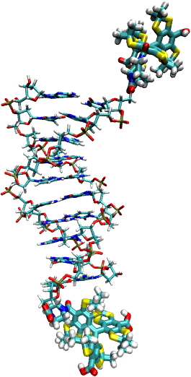
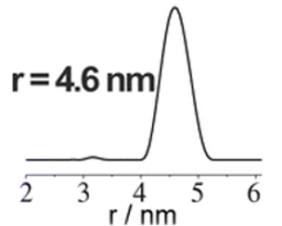
MD simulations: DNA duplex with spin labels
Short DNA duplex (10 base pairs) with attached triarylmethyl spin labels
In support of ESR spectroscopic study
R₁₂
Exp.
Shevelev G.Y. et al. // J. Am. Chem. Soc. 136, 9874–9877 (2014)

Slide 21
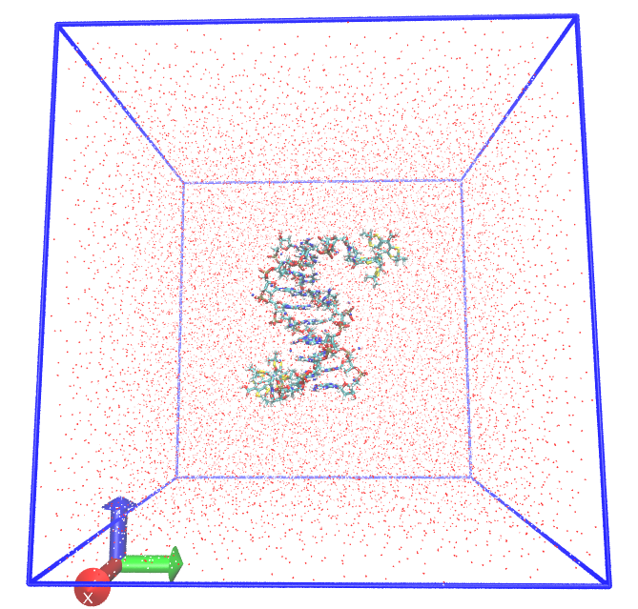
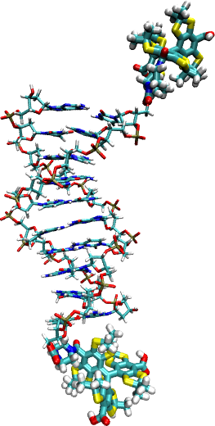

MD simulations: labeled DNA duplex in water
<exp.>
MD
Simulation box: labeled DNA + 15236 water molecules, frame from 2 μs trajectory
Kadtsyn, E. D., Anikeenko, A. V. & Medvedev, N. N. Molecular dynamics simulation of a DNA duplex labeled with triarylmethyl spin radicals. Journal of Molecular Liquids 221, 489–496 (2016).

Slide 22


Volumetric properties – apparent volume
V^{app}
V₀
Partial (apparent) volume оf a protein molecule: V^{app} = V - V₀

Slide 23
Volumetric properties - motivation
1
Partial molar (apparent) volume of a solute macromolecule and its components
V^{app}
V_{app} = V_{int} + ΔV_{water}
V_{app} = V_{M}^{vdW} + V_{M}^{empty} + ΔV_{TI}
V_{M}
V_{int} - intrinsic volume of the molecule, ∆V_{water} - contribution of the solvent
V_{M}^{vdW} - van der Waals volume of the molecule, V_{M}^{empty} - volume of internal voids
V_{M} - molecular volume, V_{TI} - thermal volume

Slide 24

Volumetry in silico: decomposition of solution
Black disks: a solute molecule.
van der Waals volume V_{M} ^{vdW}
Pink areas: intramolecular cavities
V_{M} ^{empty}
Red line: molecular border.
it includes the molecular volume V_{M}
V_{M} = V_{M} ^{vdW} + V_{M} ^{empty}
Green area: boundary voids V_{B}
Black line: Voronoi surface of the solute;
it defines the intrinsic volume of the molecule V_{int} = V_{Vor}
Voloshin, V. P., Medvedev, N. N., Smolin, N., Geiger, A. & Winter, R. Exploring volume, compressibility and hydration changes of folded proteins upon compression. Physical Chemistry Chemical Physics 17, 8499–8508 (2015).

Slide 25


Volumetry in silico: SNase protein in water
SNase in water with TMAO and urea cosolvents
N. Smolin, V.P. Voloshin, A.V. Anikeenko, A. Geiger, R. Winter, N.N. Medvedev, “TMAO and urea in the hydration shell of the protein SNase,” Phys. Chem. Chem. Phys. 19, 6345–6357 (2017).

Slide 26






MD simulations: TMAO, TBA water solutions
ТМАО
trimethylamine-N-oxide
ТМАО 1.0М solution
ТВА
tert-butyl alcohol
ТВА 1.0М solution

Slide 27

TMAO, TBA solutions: spatial homogeneity test
A.V. Anikeenko, E.D. Kadtsyn, N.N. Medvedev, “Statistical geometry characterization of global structure of TMAO and TBA aqueous solutions,” Journal of Molecular Liquids 245, 35–41 (2017).

Slide 28


MD simulations: collective motions in water
5% of the longest vectors of mean displacement $\left\langle ∆\vec{R}\right\rangle$ of molecules in spheres, 30x30x30 grid. From MD water model with 50 000 molecules at T = 310K, Δt = 100 ps.
R_{sph} = 1.46 nm, ~433 molecules in averaging sphere
Periodic k-d trees for fast neighbor search, VTK + Paraview for visualization

Slide 29


MD simulations: collective motions in water
A.V. Anikeenko, G.G. Malenkov, Y.I. Naberukhin, “Visualization of the collective vortex-like motions in liquid argon and water: Molecular dynamics simulation,” The Journal of Chemical Physics 148, 094508 (2018).

Slide 30
Concluding remarks
Coordinates of particles in atomistic simulations contain a lot of “hidden” structural information
Tools of computational geometry are very useful in extracting a structural knowledge from simulation data
Visualizations help in research, but for quantitative physical results we need properties that can be averaged over multiple configurations

Slide 31
Points of contact
My background:
Molecular dynamics simulations
Application of Voronoi diagrams to structure analysis in physics and structural bioinformatics
My interests ∩ KIV:
Molecular visualization
Compact storage, fast processing of tetrahedral meshes
GPU-accelerated computing of VD primitives and its properties (volumes, surface areas)
Metrics of spatial (in)homogeneity, spatial correlations

Slide 32

Acknowledgments
Mobility 3.0 project, CZ.02.2.69/0.0/0.0/16_027/0008370
Prof. Dr. Ing. Ivana Kolingerova, ZČU, Plzeň
Members of MDS laboratory in ICKC Novosibirsk who contributed to the presented results: N. Medvedev, V. Voloshin, E. Kadtsyn, A. Kim, Yu. Naberukhin, E. Shelepova
Colleagues and co-authors from all around the world
Thank you for your attention!

